Slide 1

airbnb
DATA SCIENCE CAPSTONE PROJECT USING AIRBNB DATA FOR THE CITY OF SEATTLE
By
Samuel Wood
Swaraj Patil
Kalyan Chatterjee
Ben Zachariah

Slide 2

TABLE OF CONTENTS
INTRODUCTION
BUSINESS GOALS
EXPLORATORY DATA ANALYSIS & DATA VISUALISATION
HOST & CUSTOMER SEGMENTATION
RECOMMEND HOUSE TYPE
CONCLUSION
airbnb

Slide 3

INTRODUCTION
Airbnb, Inc. is an American company that operates an online marketplace for lodging, primarily homestays for vacation rentals, and tourism activities.
Airbnb does not own any of the listed properties; instead, it profits by receiving commission from each booking.
Guests often find Airbnb is cheaper, has more character, and is homier than hotels.

Slide 4
BUSINESS GOALS
EDA AND DATA VISUALISATION
Data is cleaned and treated to get various insights into the home rental business from the perspective of Property owner and the Customer.
HOST & CUSTOMER SEGMENTATION
Analyze the data and figure out the best way to identify the optimal clusters and what sort of travelers and hosts fit into each of these clusters.
RECOMMEND HOUSE TYPE
What kind of a property is a customer likely to rent out. Getting insights into the .If rental agencies can get an insight into the customer requirements, they can display only the relevant houses.
airbnb

Slide 5
airbnb
EDA AND DATA VISUALISATION

Slide 6
DATA CLEANING
1. NULL VALUE TREATMENT
Data contains 3818 rows and 92 columns.
Null values in columns like cleaning fee, notes are filled with “NA”.
Filled null values in neighbourhood column using backfill method.
All relevant columns which are numerical features are filled with the mean values.
2. DATA TREATMENT
Converted price and date from object type to integer.
Dropped irrelevant columns like scrapping ID, listing_URL.
airbnb

Slide 7

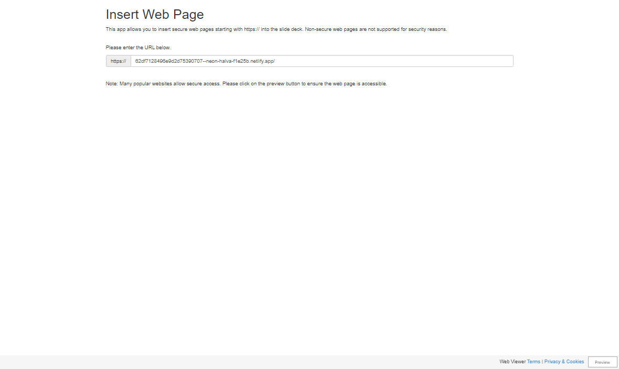
airbnb

Slide 8
airbnb
HOST & CUSTOMER SEGMENTATION
How are these clustering of hosts useful to Airbnb from a business point of view?
How are these clustering of customers useful to Airbnb from a business point of view?

Slide 9

FEATURE ENGINEERING FOR HOST SEGMENTATION
(All calculation shown are done by our own intuition and are subject to change as per domain expertise)
Response score: This score is directly proportional to the host response rate and inversely proportional to host response time.
Verification score: Score created by using the total number of verifications(45%), has profile pic (15%) and if the host is verified or not(40%).
Hosting score: Score created using the host acceptance rate(20%), if host is a superhost or not(35%), total listings under host(10%) and the hosts experience(35%)
Property score: Score created by using the number of amenities, number of bedrooms and total capacity.
$$Response Score=\frac{Response Rate}{Response Time}$$
$$Verification Score=Number of Verifications ∗0.45+Host Profile Pic∗0.15+Verifies Identity ∗0. 4$$
$$Hosting Score=Acceptance Rate∗0.2 +Super Host ∗0.35 +Total Host Listings∗0.1 +Host Experience ∗0.35$$
$$Property Score=Total Amenities∗0.5 +Total Bedrooms∗0.25+Total Capacity ∗0.25$$

Slide 10
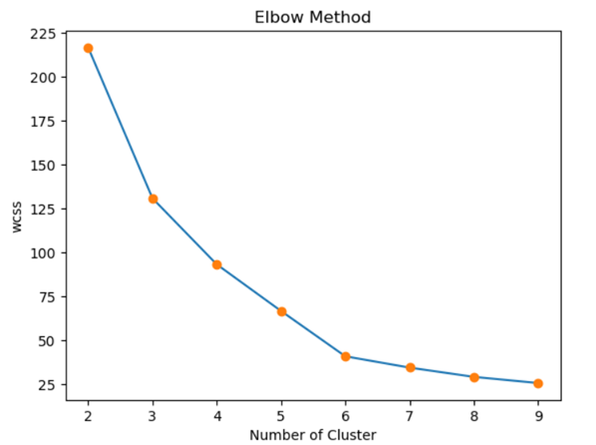
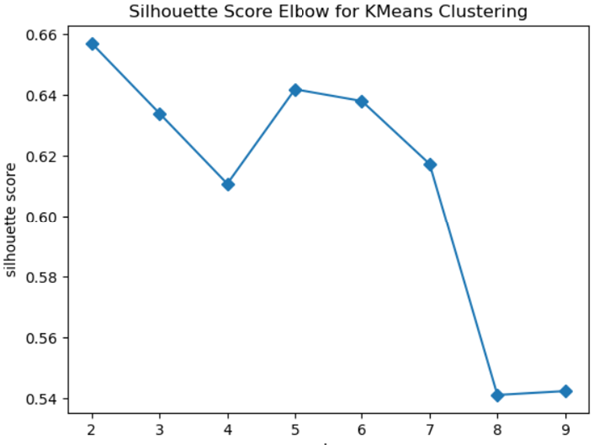
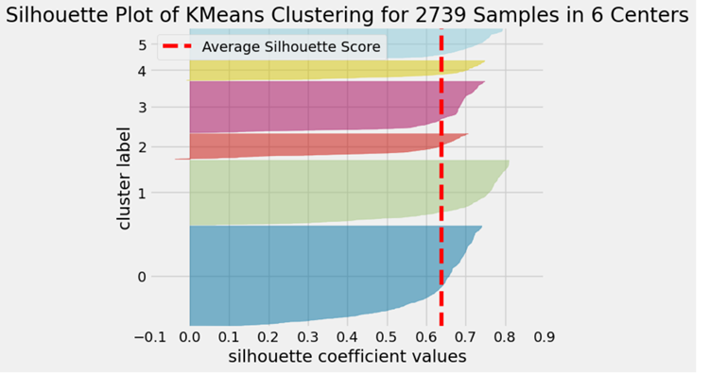
HOST SEGMENTATION
For this problem, we used the engineered columns in various methods to find the ideal number of clusters
From the elbow method we find 6 to be ideal number of clusters.
From the silhouette score, we can see that the elbow values is 2,5 or 6.
In the Silhouette Visualizer, for k=6 the instances are distributed evenly.
Therefore, We are Considering number of cluster = 6 for our model.

Slide 11
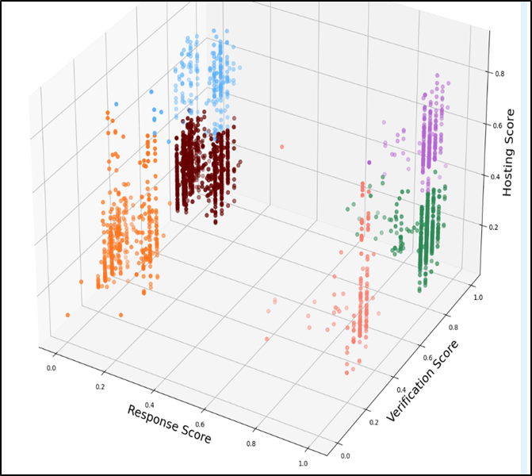
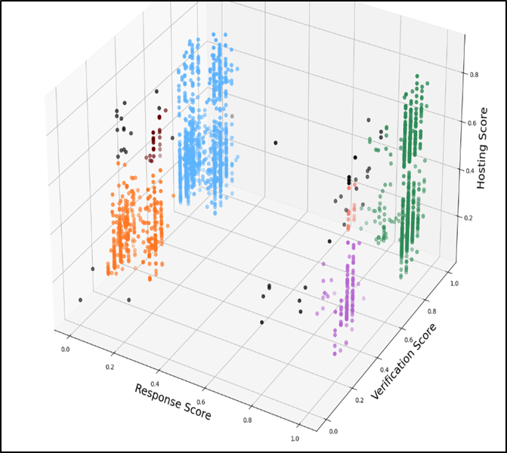
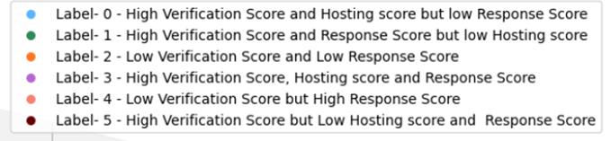
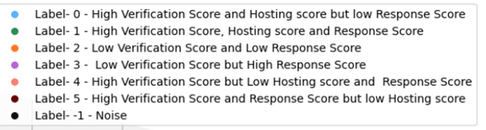
MODEL SELECTION FOR HOST SEGMENTATION
In K-means clustering, the clusters created tend to overlap one another.
In DBSCAN clustering, the clusters made are clean with no overlapping, but many data are lost to outliers.
Also, in DBSCAN, some of the clusters formed are uneven in size.
K-MEANS CLUSTERING
DBSCAN CLUSTERING

Slide 12
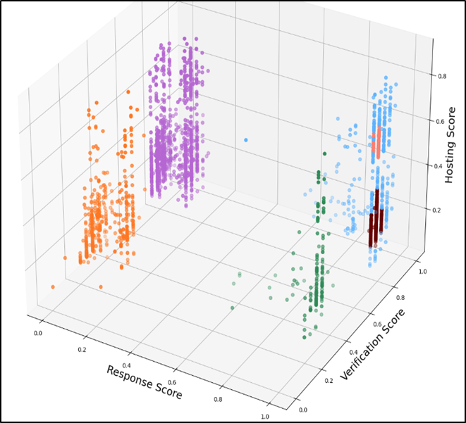
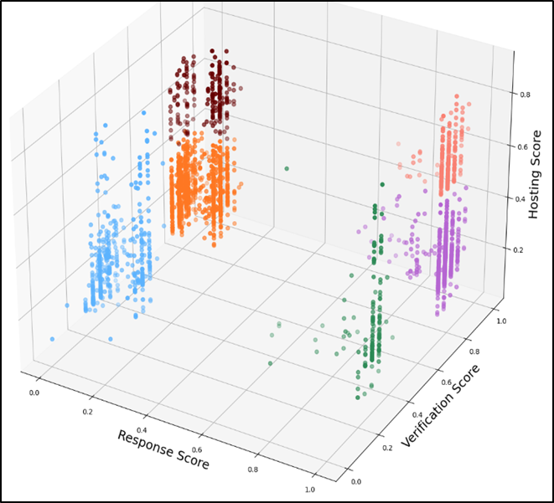
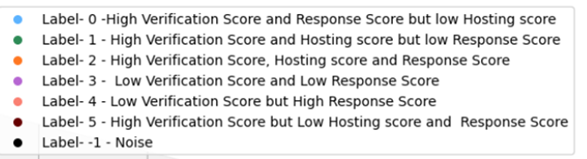
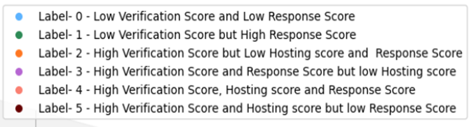
MODEL SELECTION FOR HOST SEGMENTATION
In HDBSCAN clustering, the clusters created tend to overlap with other clusters as well.
In Agglomerative clustering, the clustering is clean with no overlapping. Clusters created are also similar in size.
Considering the problems faced in other models, Agglomerative clustering has worked best for the given data.
Due to this, Agglomerative is selected as the final model.
HDBSCAN CLUSTERING
AGGLOMERATIVE CLUSTERING

Slide 13
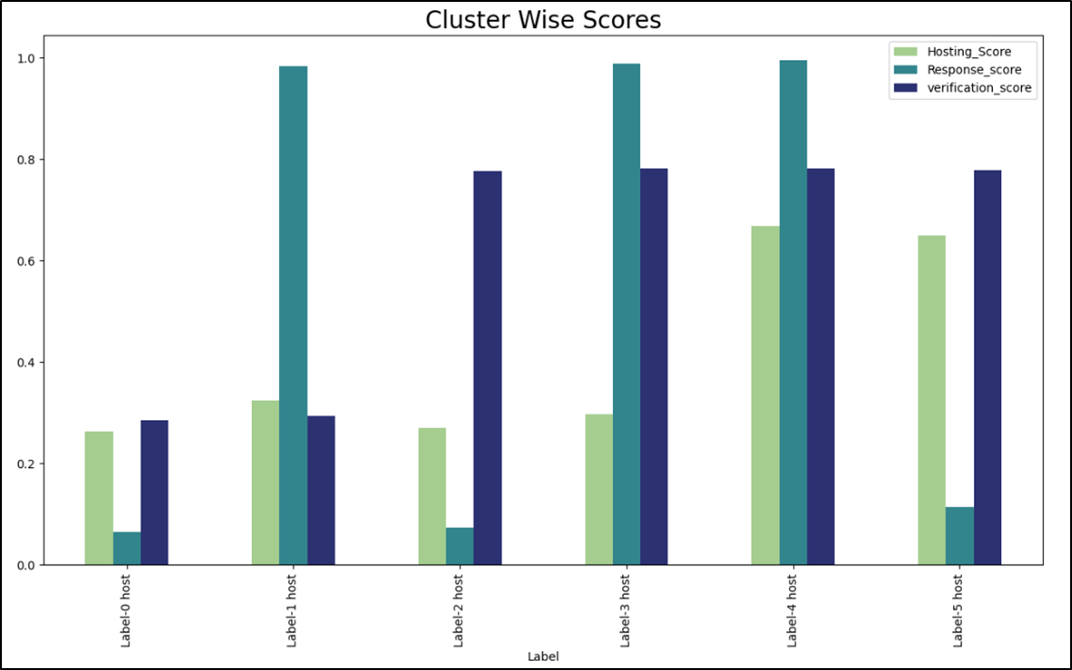
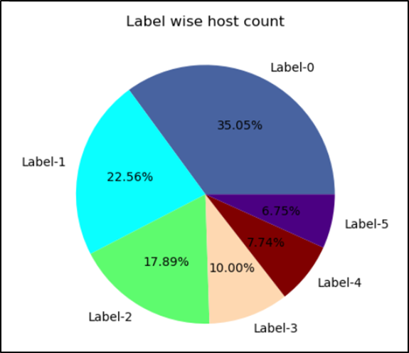
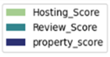
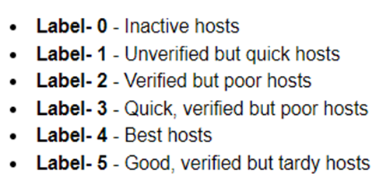
HOST SEGMENTATION

Slide 14
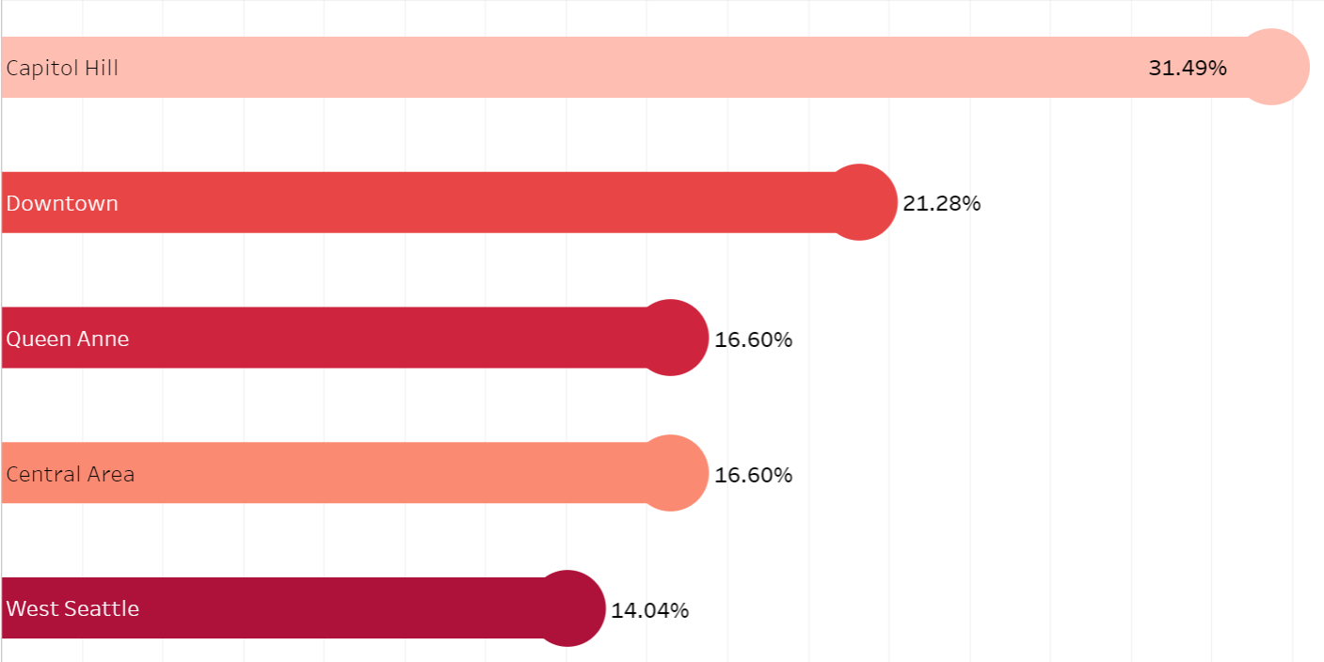
BUSINESS USES AND ADVANTAGES:
This clustering allows Airbnb to provide valuable feedbacks to the hosts.
With this, Airbnb can rectify each individual host’s shortcomings.
For example, the host who falls in label-5 are good hosts with high verification stores but their response rate is quite slow.
Therefore, the said hosts require to be more alert in order to respond to queries from interested customers much faster.
airbnb
Percentage count of hosts in different neighbourhood

Slide 15
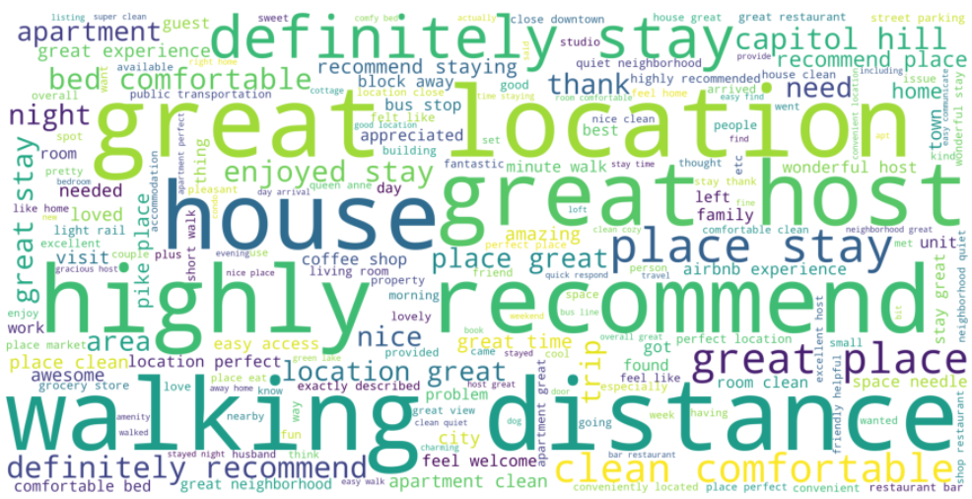
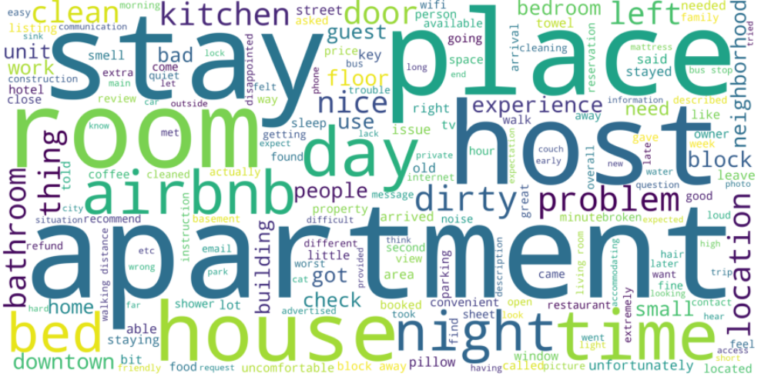
CUSTOMER SEGMENTATION
For customer segmentation, we used customer reviews dataset.
After which, we conducted sentiment analysis of the reviews and gave them review score.
Majority of the reviews in the data were Positive (95%)
We used engineered columns(Review_score, property_score, Hosting_score) for clustering analysis.
airbnb
POSITIVE SENTIMENT WORD CLOUD
NEGATIVE SENTIMENT WORD CLOUD

Slide 16
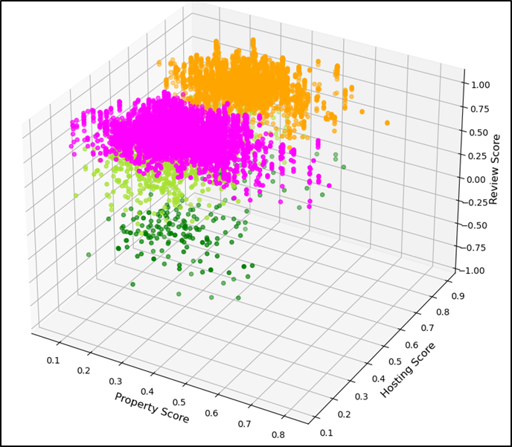
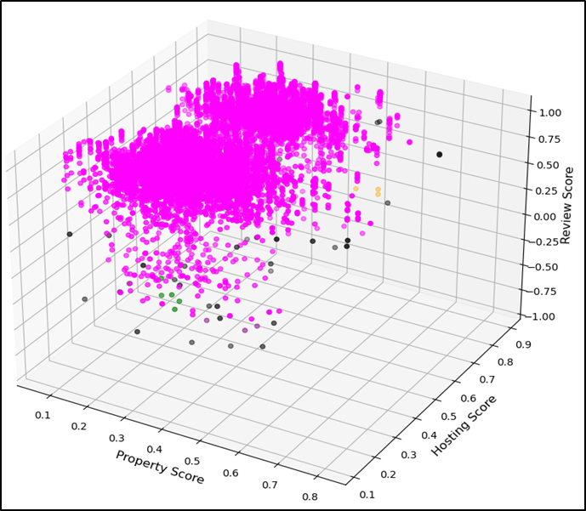
MODEL SELECTION FOR CUSTOMER SEGMENTATION
Due to the huge data size, all the clustering models, except K-Means, are not able to run on the whole data.
Due to this, only 10% of data is fed to the models.
In Agglomerative clustering, only 4 clusters are created, and the sizes are inconsistent.
In DBSCAN clustering, all data points are added to a single cluster.
AGGLOMERATIVE CLUSTERING
DBSCAN CLUSTERING

Slide 17
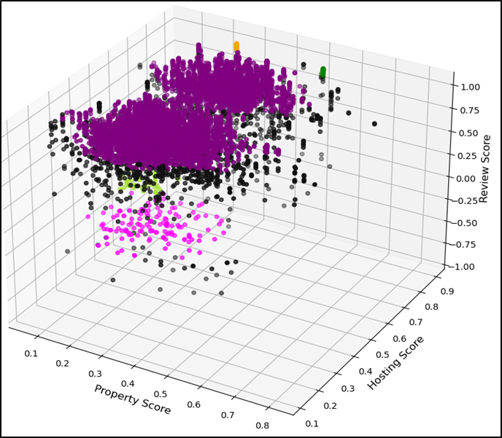
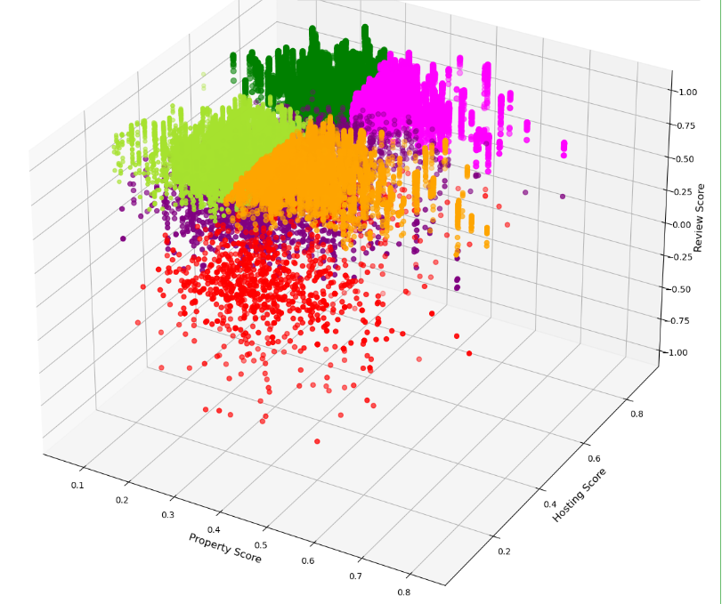
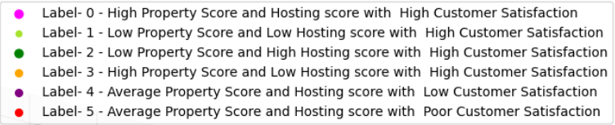
MODEL SELECTION FOR CUSTOMER SEGMENTATION
In HDBSCAN, many data points are lost due to being classified as outliers.
Data points are also not evenly distributed among the clusters.
In K-means clustering, data points are almost equally divided among the groups, with almost no overlapping.
As seen, K-means model provides the best clustering for the given data.
FIG 3.10: HDBSCAN CLUSTERING
FIG 3.11: K-MEANS CLUSTERING

Slide 18
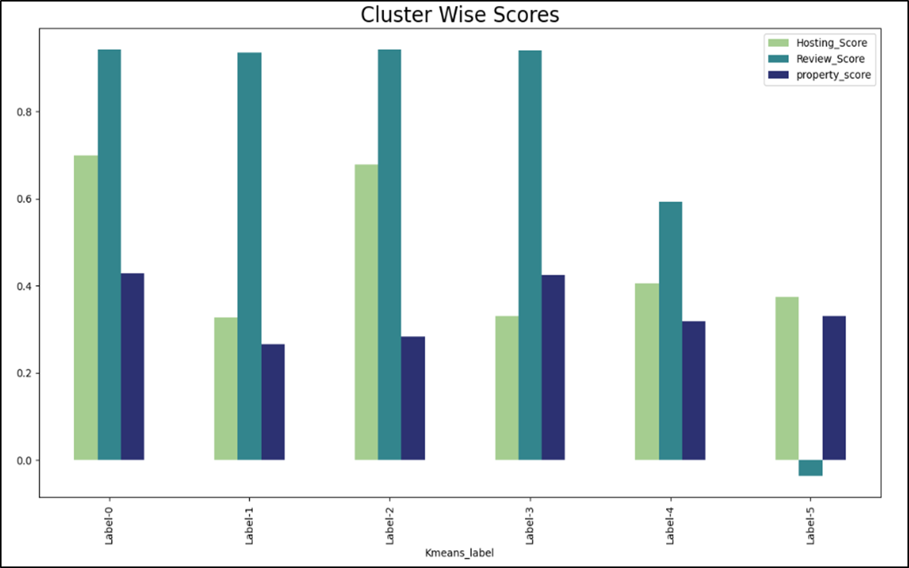
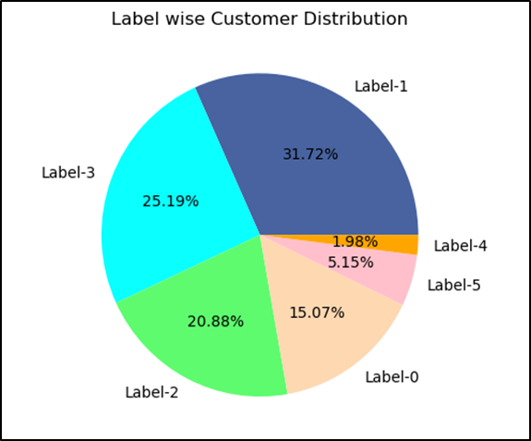
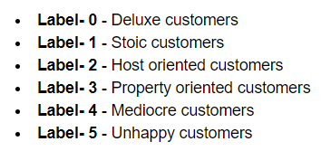
CUSTOMER SEGMENTATION

Slide 19
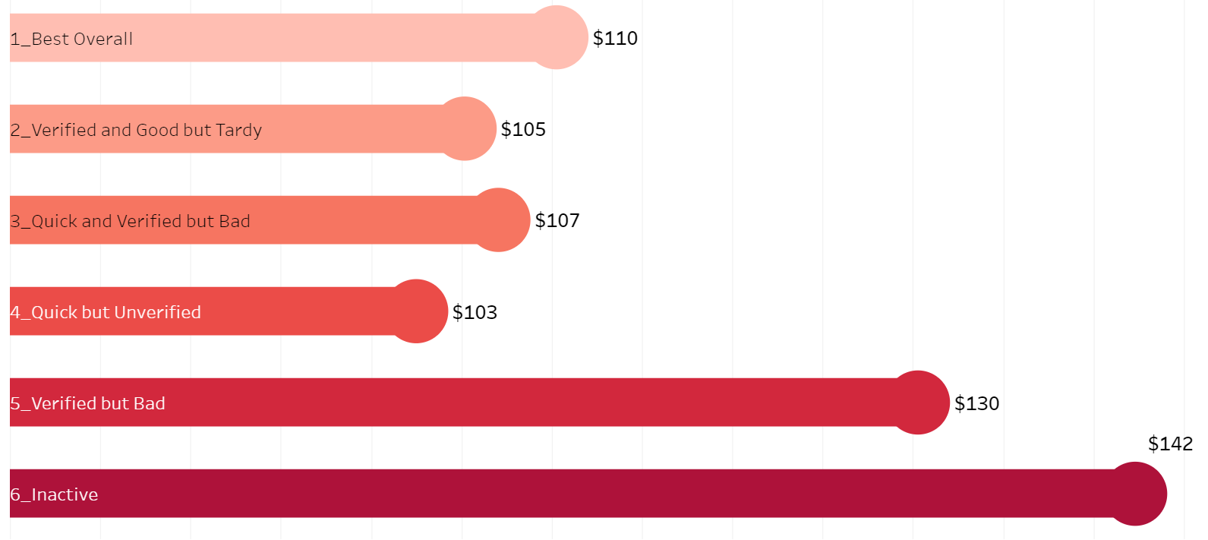
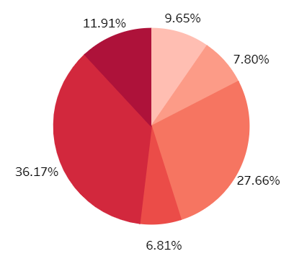
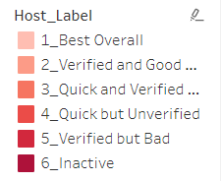
BUSINESS USES AND ADVANTAGES:
From this, we find that customers who fall under label-0 to label-4 are the customers who mostly have had a good experience with Airbnb and will most likely be recurring customers.
The unhappy customer (Label-5), require immediate attention. To understand their problems, we will conduct further analysis.
airbnb
6
1
2
5
3
4
Average price of property for different hosts of unhappy customers
Host composition for unhappy customers
The properties that the unhappy customers picked have hosts who generally fall under the category of low quality hosts. The said host’s properties are much more expensive as well.
To conclude, the unhappy customers can be happy when the poor hosts are corrected and property prices are lowered.

Slide 20
airbnb
RECOMMEND HOUSE TYPE

Slide 21
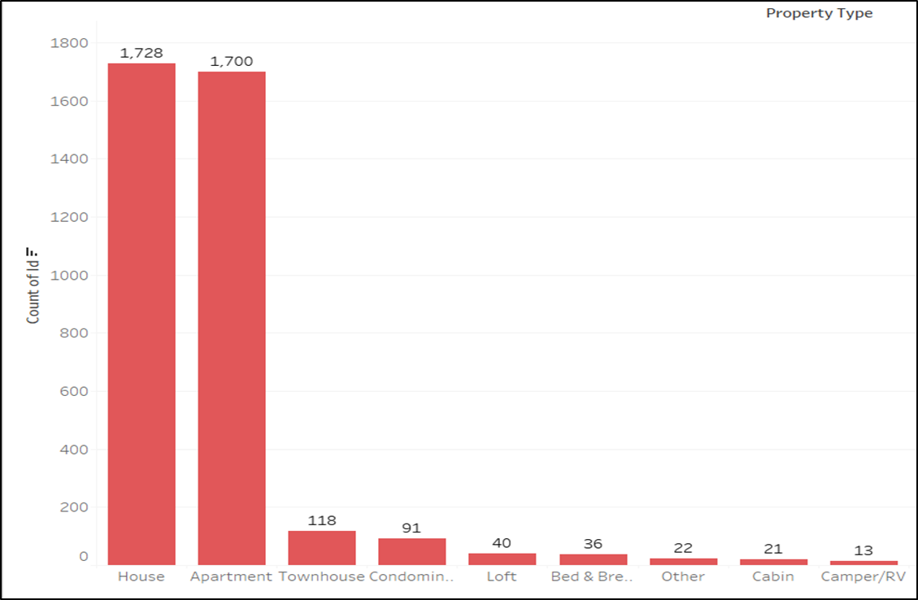
DATA MODIFICATION
Most common properties type in the given data are houses and apartments
Remaining types of properties are very scarce in number. They affect the accuracy of the model in a negative way.
Thus, we will only consider only Houses are Apartments for further Classification.

Slide 22
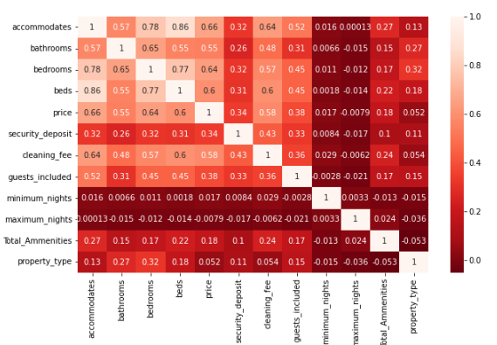
DATA ANALYSIS
Feature’s given below have high correlation with Property_Type:
Accommodates
Bathrooms
Bedrooms
Beds
Security_deposit
Guests_included
Price
Cleaning_fee
Total_Ammenities

Slide 23
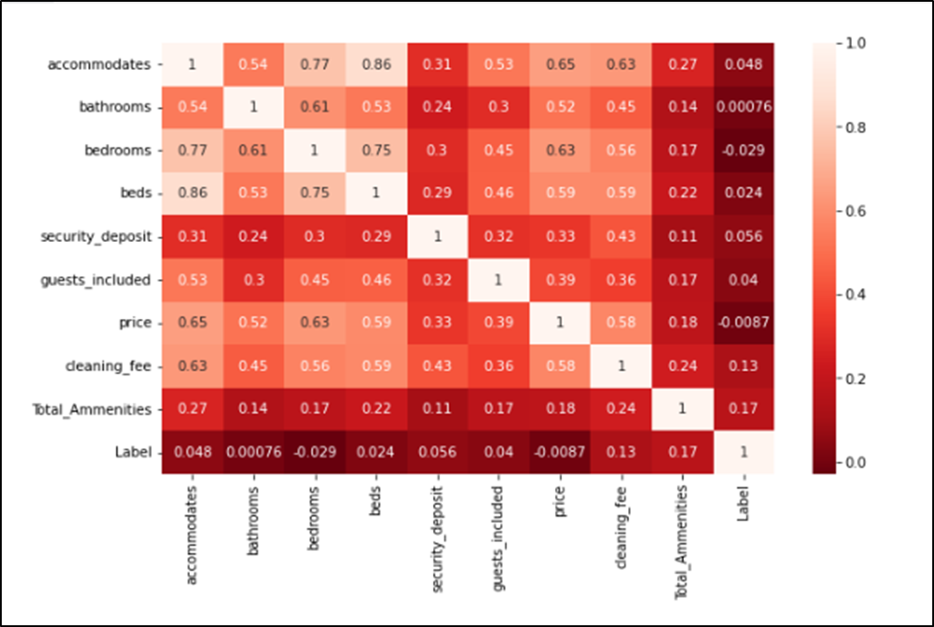
DATA ANALYSIS
We can observe that there is multi-collinearity between the selected features.
Therefore, some feature engineering need to be done with these features
We'll Merge:
Price and cleaning fee
Guests_included and Accomodates

Slide 24
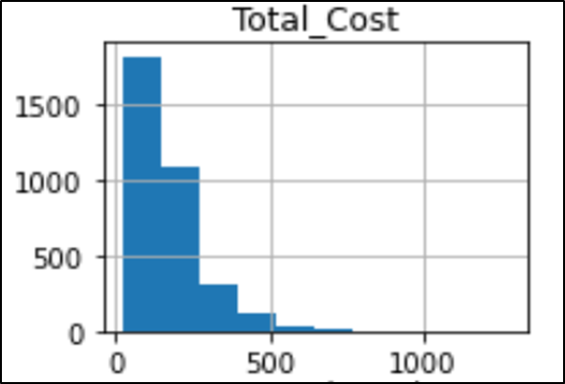
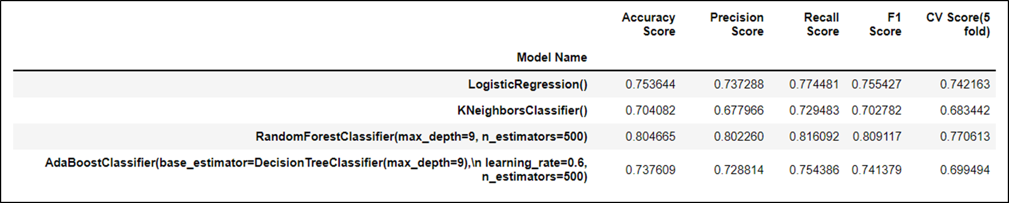
RECOMMEND HOUSE TYPE
The Total_cost data is right skewed as shown.
To convert it into normally distributed data, we are applying natural log to the data.
From the table below, we can see the performance of various models.
The Random Forest classifier has the best performance with 80% accuracy.

Slide 25
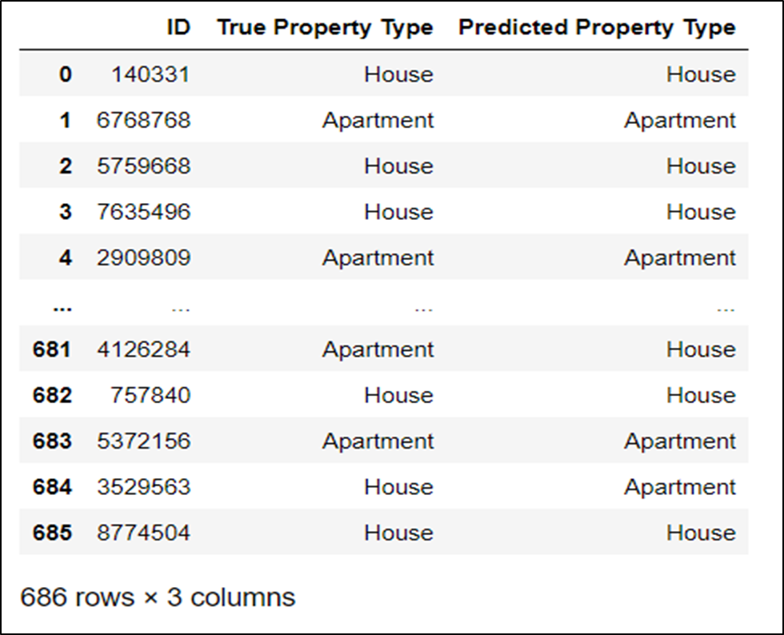
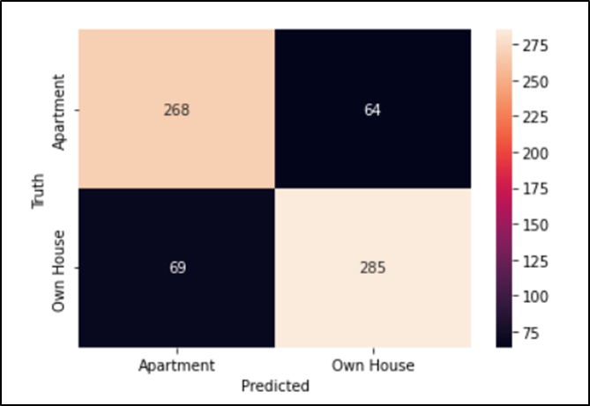
RECOMMEND HOUSE TYPE
After fitting the final model, we are getting overall accuracy of 80% on the test set, and a 5-fold CV score of 77%. This suggests that this is a well fit model.
Out of 686 instances, the model can predict 553 instances correctly.

Slide 26
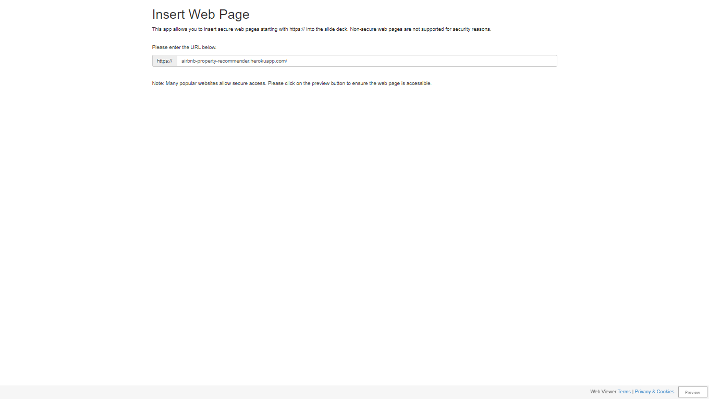

Slide 27




References
Dataset (Seattle) :
Workbook :
EDA using Tableau :
Property Recommender :
airbnb

Slide 28
airbnb
THANK YOU

